Slide 1
SoulPactum
Create it: Pisti Demeter, Norbert Sándor, Patrik Dávid Szivós

Slide 2
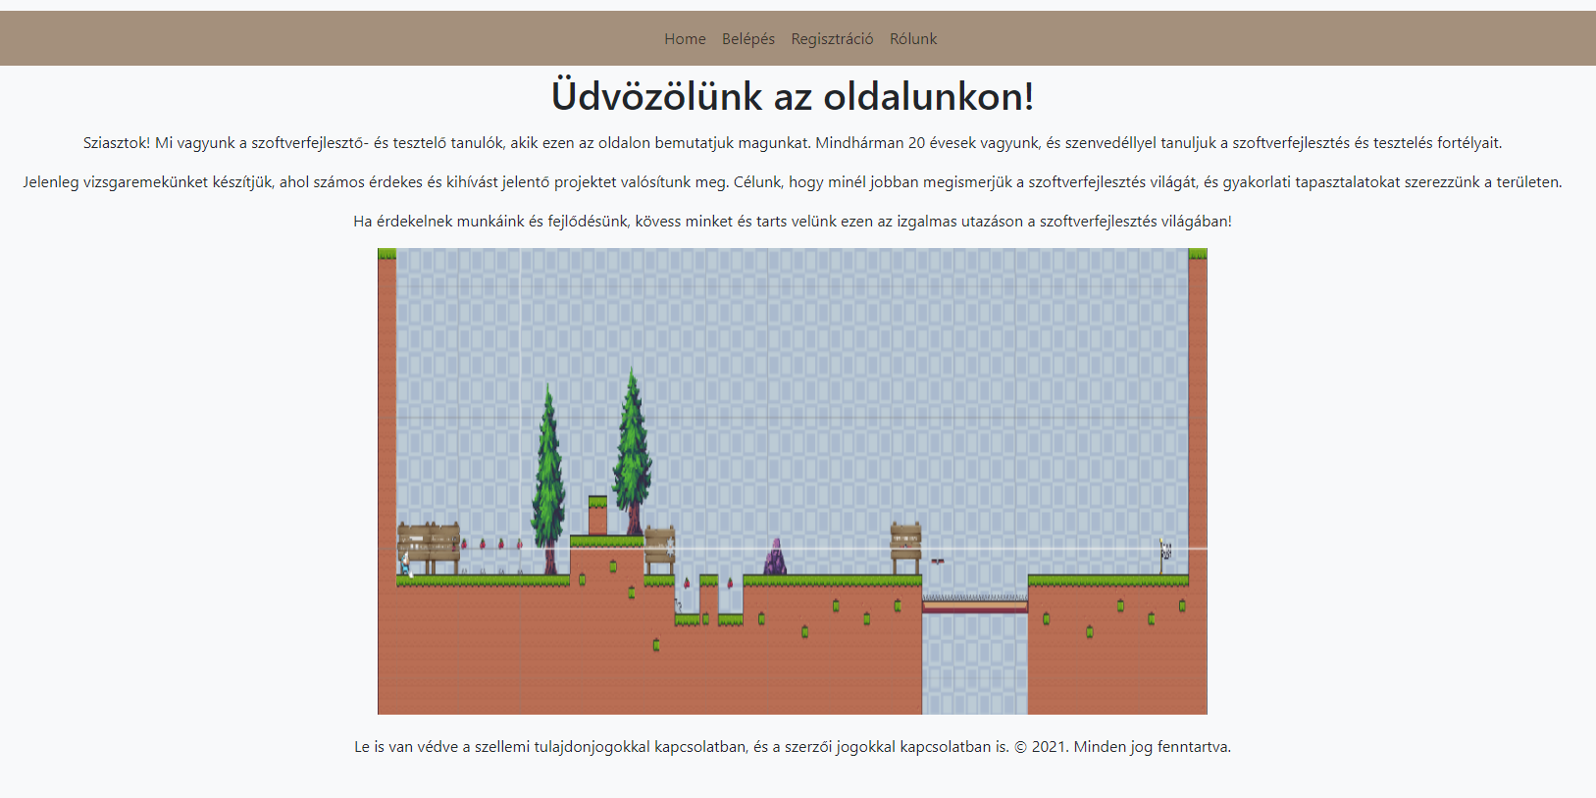
Home
There are four buttons:
Home
Belépés
Regisztráció
Rólunk

Slide 3
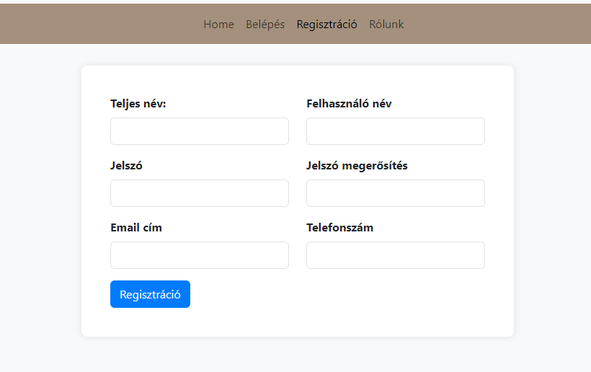
Registration
In this page we ask you to add to us your:
Username
Full name
Emai address
Phone number
Password

Slide 4
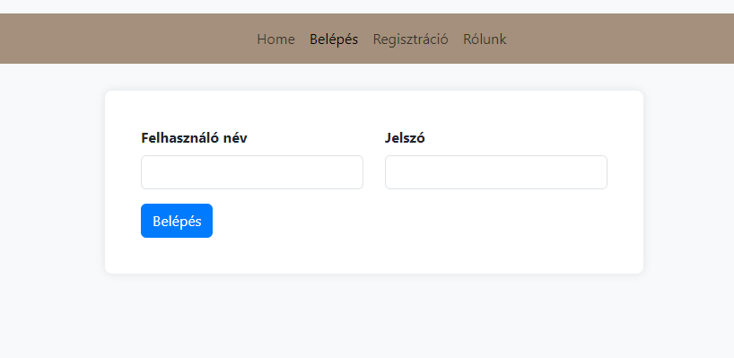
Login
Here if you are already registered you need to know:
Username
Password

Slide 5
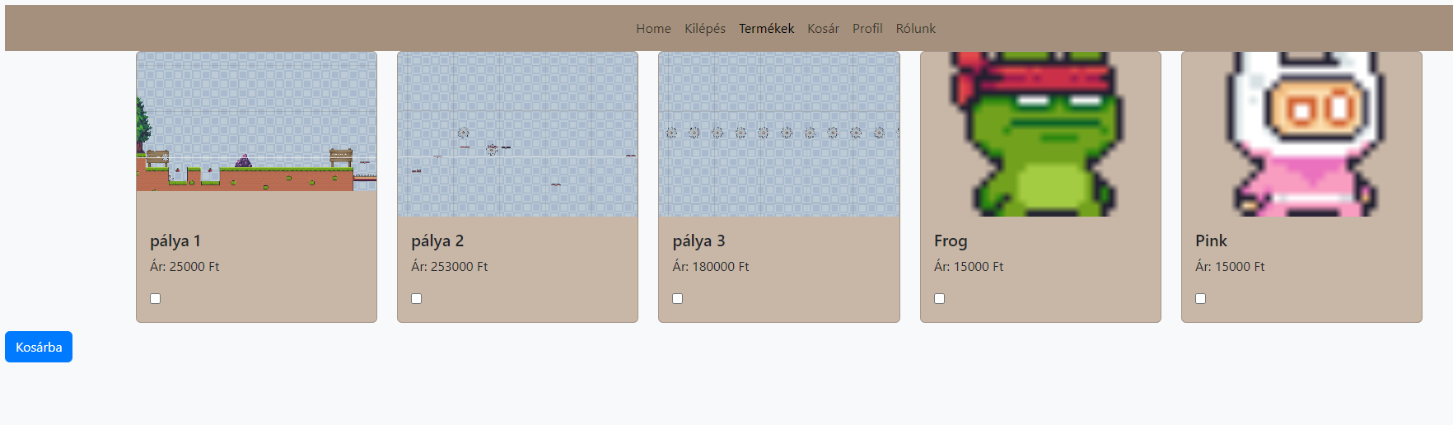
Products
Here you only can see this page if you are loggedin
Choose the products you need and add to the cart.

Slide 6
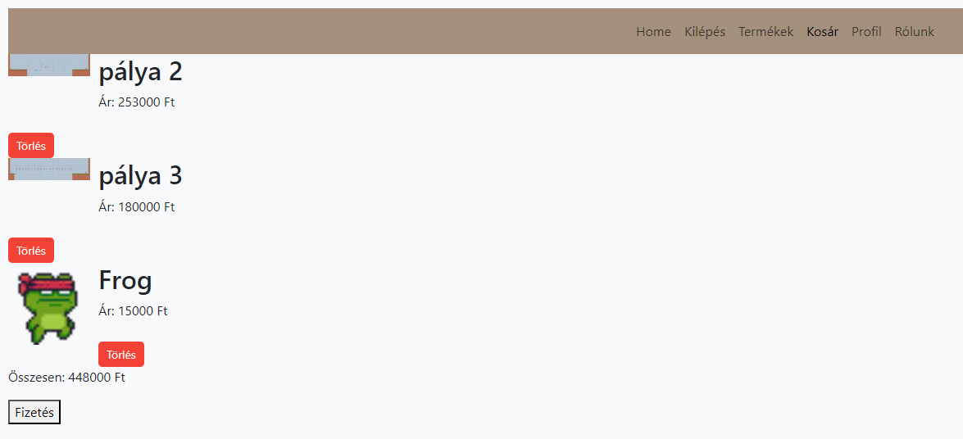
Cart
List of the items
Total price
„Fizetés” button – pay the items

Slide 7
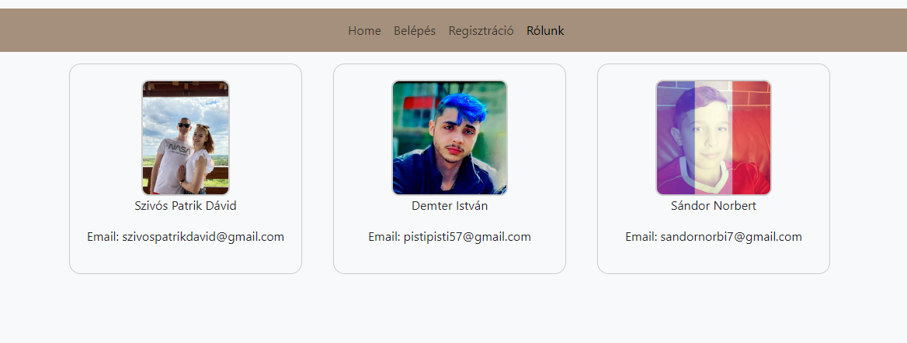
Who we are?

Slide 8
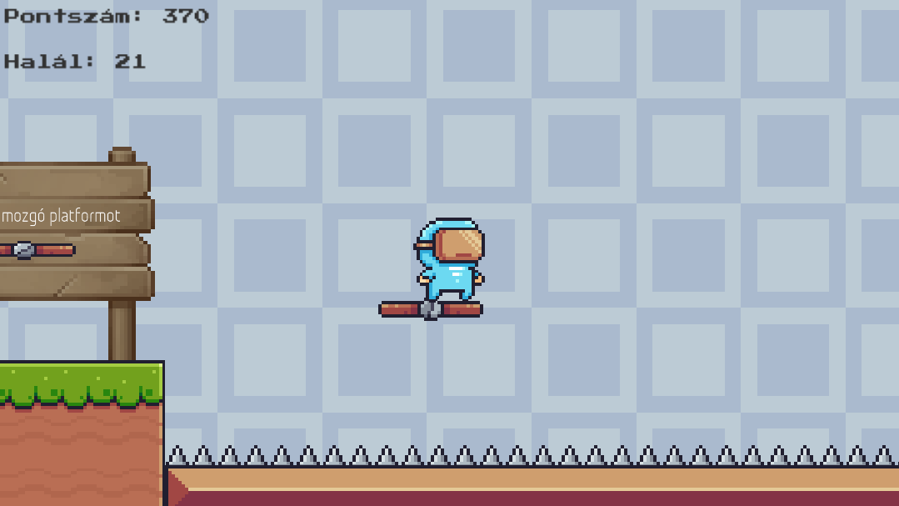
The game
Engine
The type of game
Target audience
Our goal

Slide 9
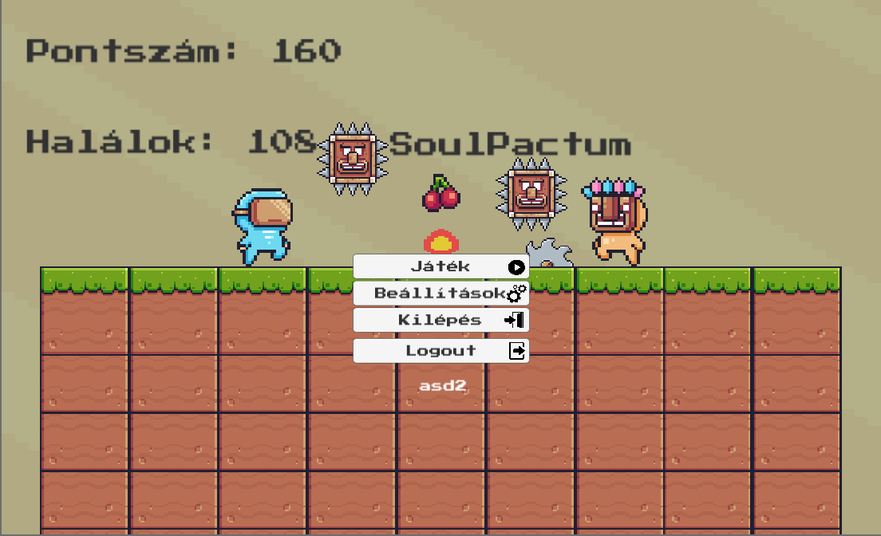
Main menu
Player informations
Game name
Player name

Slide 10
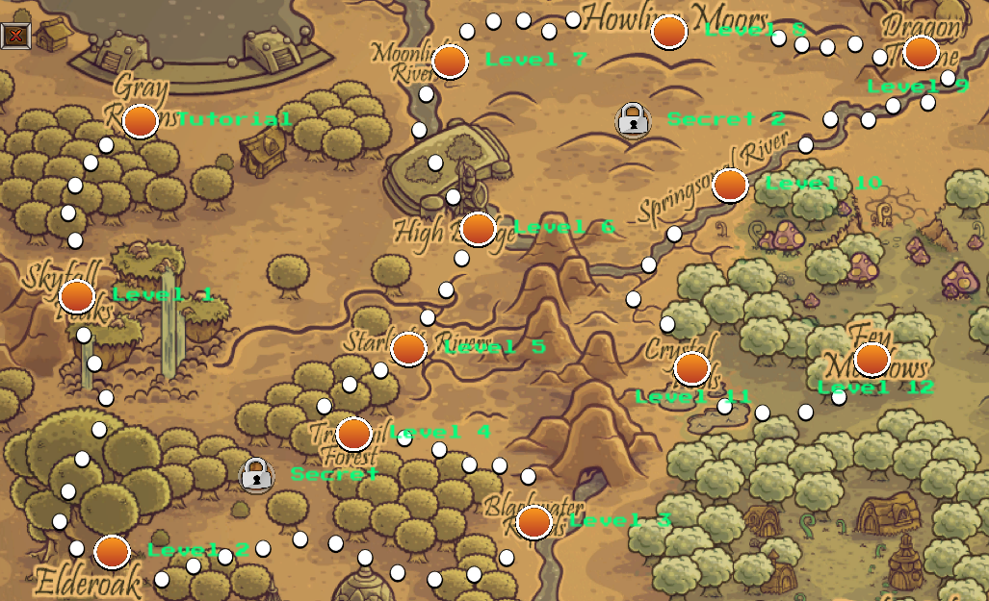
Map
More levels coming soon
Secrets
Plans

Slide 11
Implementation
Programing languages:
Why? Because…
C#
PHP
phpMyAdmin
Challenge
Experience
Preferred

Slide 12
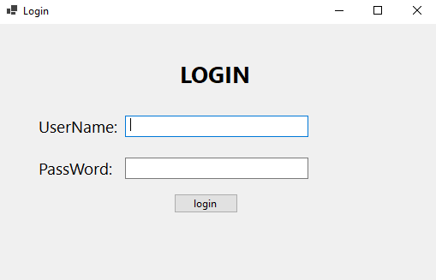
Login
You can log in to the admin interface here
You must enter a username and password

Slide 13
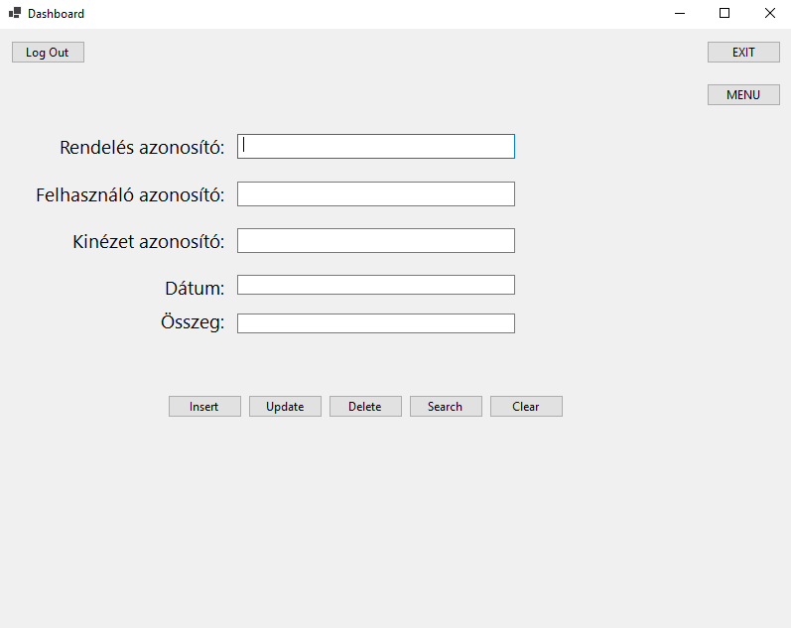
Order
After successful login, this page welcomes the admin
There are eight buttons

Slide 14
Thank you so much!

